Slide 1
Midwifery Education and Accreditation in the U.S.
Katherine Camacho Carr, CNM, PhD, FACNM

Slide 2
What is accreditation?
The goal of accreditation is to ensure that education provided by institutions of higher education meets acceptable levels of quality.
Accrediting agencies, such as MEAC & ACME, are both approved as accrediting bodies by the USDE.
U.S. Department of Education www.ed.gov/admins/finaid/accred/index.html
Notes:
The US Department of Education & the Council for Higher Education Accreditation (a non-governmental organization) both recognize reputable accrediting organizations and provide guidelines and resources relevant to accrediting bodies. They do not accredit individual programs or institutions.

Slide 3
What is accreditation?
Accrediting agencies, which are private educational associations of regional or national scope, develop evaluation criteria and conduct peer evaluations to assess whether or not those criteria are met.
Regional accreditation organizations for Higher Education
Notes:
ACME is national in scope, while accrediting agencies for universities, colleges and other institutions of higher learning are regionally accredited, based on their geographic region.
Institutions and/or programs that request an agency's evaluation and that meet an agency's criteria are then "accredited" by that agency.

Slide 4
What do accrediting agencies do?
Set quality standards based on current best practices in higher education
Require periodic self and peer evaluations based on those standards
Support schools in meeting those standards
Collect annual data from their members
Provide a grievance and disciplinary process when needed

Slide 5
What is the value of accreditation to the public & the profession?
Accreditation provides quality assurance to the public & continuous quality improvement thru a process of self-evaluation and feedback from other educators
Assures that a neutral, external party (the accrediting organization) has reviewed the quality of education provided and has found it to be satisfactory, based on peer expertise and evaluation.
Confirms that institutions and programs have processes in place to meet changes in thinking or practice and in the public’s expectations.
Accreditation promotes accountability of programs/institutions to their peers, their students, and the public
Accreditation builds a community of midwifery educators and an understanding within the profession of the role and value of education, while providing opportunities for professional development.

Slide 6
What is the value of accreditation to the students & programs?
Accreditation assures that the education provided meets the requirements for national certification, aiding with the entrance to most professions, especially those which require certification & licensure.
Accreditation by a recognized accrediting body allows institutions to participate in federally-funded student financial aid & program funding
Accreditation assures that student rights are protected and responsibilities to the student are clearly defined.

Slide 7
What is the value of accreditation to the students & programs?
Accreditation enables students to more easily transfer credits among accredited institutions or programs, enabling student mobility and easier access to advanced degrees.
Students can have confidence in an accredited program, educational pathway or institution that the quality of education provided meets standards and has been reviewed by outside experts, without a conflict of interest.
Accreditation of programs and institutions also signals to potential employers that the graduates of the accredited program meet accepted standards.

Slide 8
What is the typical relationship between accreditation, certification and licensure?
Accredited Education
Pathway
Certification
Licensure

Slide 9
Midwifery in the U.S.
Nationally Certified Midwives
CNMs/CMs
CPMs
Other Midwives
State licensed midwives who are not certified
Unlicensed midwives who may or may not be certified
Notes:
Our focus for this presentation will be on nationally certified midwives. CNMs are recognized in all 50 states, but it is important to note that not all states that regulate midwifery require certification for direct entry midwives and there are still 25 states that do not provide for the licensure of direct-entry midwives at all. This means the conversation about national standards for midwifery education would first and foremost have to provide assurance to the public that midwives educated in the U.S. would provide high quality, safe and cost effective care in all settings.
This means that the conversation about national standards for midwifery education will ultimately have to take into account the practical implications of access, cost, and relevance within that context. National standards for midwifery education would first and foremost have to provide adequate protection for the public.

Slide 10
CNM/CM Education
CNMs and CMs must graduate from an educational program accredited by the Accreditation Commission for Midwifery Education (ACME)
CNMS/CMs are then certified by the American Midwifery Certification Board (AMCB)
Education programs are housed within or must articulate with an academic degree program at the graduate level.

Slide 11
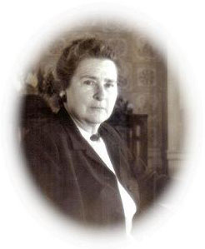
CNM/CM Education: Historic Roots
Mary Breckinridge brought nurse-midwifery to the U.S. in 1925, founding the Frontier Nursing Service.
Hazel Corbin, Director General of the Maternity Center Association, starts the Lobenstine Midwifery School, the first nurse-midwifery education program in the U.S. in NYC in 1931
Notes:
Providing care to vulnerable populations and providing woman and family centered care in all settings are still strong values in CNM/CM education. Of course, FNS midwives provided home birth services that greatly improved maternal and infant outcomes in rural Appalachia. The Maternity Center Association provided the proto type out of hospital birth center for nurse-midwifery practice.

Slide 12
CNM/CM Education: Setting National Standards
1955 American College of Nurse-Midwifery (ACNM) incorporated
1957 Curriculum & Approval Committee
1965 ACNM establishes accreditation criteria
1968 First site visits
1970 National accreditation fully in place
1971 ACNM required graduation from an accredited program and passing score on national exam for certification for CNMs
1978 Core competencies adopted, instead of standardized curriculum, to encourage flexibility; applied regardless of certificate or degree level of program (Competency based curriculum)
Notes:
One of the initial objectives of ACNM was to evaluate and approve midwifery education programs and in 1957 a special committee on Curriculum and Approval was formed. The Committee drafted the first documents: Criteria for Accreditation of Basic Certificate, Basic Graduate and Pre-Certification Nurse-Midwifery Education Programs, based on the core competencies, establishing competency-based education programs. The core competencies were developed and are updated periodically, based on a research survey (or task analysis), which identifies the tasks that midwives perform in the health care system at the time. This information is then analyzed in order to adjust the required knowledge and skill set contained in the core competencies and ultimately tested in the certification exam.

Slide 13
CNM/CM Education: Setting National Standards
1982 - U.S. Department of Education (USDOE) recognizes the ACNM Division of Accreditation (DOA) as a national accrediting body for nurse-midwifery education programs.
1994 - ACNM DOA identified the competencies essential to midwifery practice in nursing that would be required for direct entry midwifery and in 1996 DOA preaccredited the first CM program.
2000 – ACNM DOA is renamed the Accreditation Commission for Midwifery Education (ACME)
2003 – 2012 USDOE approves ACME to accredit institutions, as well as programs within institutions
Notes:
The Accreditation Commission for Midwifery Education (ACME), formerly called the Division of Accreditation, has maintained national recognition from the US DoE as an accrediting body for nurse-midwifery and midwifery education programs, separate from nursing, for more than three decades.

Slide 14
Organization & Administration of ACME
Accreditation Commission for Midwifery Education
(ACME)
Board of Commissioners
American College of Nurse-Midwives
Board of Directors *
ACME Advisory Committee
------
Site Visitor Panel
Board of Review Chair
ACME Staff
Notes:
The Accreditation Commission for Midwifery Education (ACME) is an administratively and financially autonomous commission of the American College of Nurse-Midwives (ACNM). The purpose of ACME is to plan, implement, evaluate and monitor the accreditation process of midwifery education programs or institutions that offer midwifery education in order to assure quality in an educational program and/or an institution that offers midwifery education. ACME consists of four (4) units: Board of Commissioners, Site Visitor Panel, Board of Review (BOR) and Advisory Committee. The Board of Commissioners is responsible for the administration of ACME activities, formulation of policy, and the development of the criteria used by the BOR in determining accreditation status.
The BOR is responsible for review of an applicant’s Preaccreditation Report (PAR) or Self-Evaluation Report (SER) and the Site Visit Report (SVR), and determination of accreditation status.
The Site Visitor Panel arranges, conducts, and evaluates visits to midwifery education programs or institutions.
The Advisory Committee provides input to the Board of Commissioners in the areas of development of policy and evaluation of ACME. The Advisory Committee is composed of members representing nursing, medicine, education, public health and the public, as well as the immediate past chair of ACME. The chart shows the organizational structure of ACME.

Slide 15
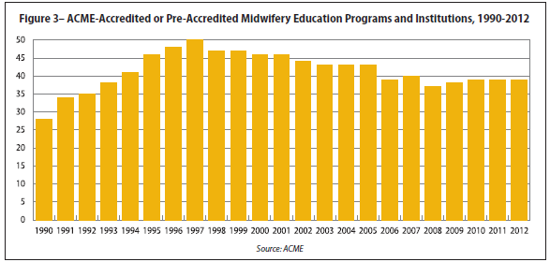
CNM/CM Education: Landscape Today
Notes:
Currently, there are 39 ACME accredited education programs.

Slide 16
CNM/CM Education: Landscape Today
6 of 39 ACME accredited programs provide majority of didactic material through online curricula
2 of 39 program prepare CMs
More than half offer option for bachelor’s prepared individuals to enter an accelerated nursing program (1 year), then continue for midwifery and a graduate degree (2 years)
DNP | MN/MSN or DNP | MSN/MN | MSN or MPH | MPH
3 | 6 | 28 | 1 | 1
Notes:
Since a graduate degree is required to take the certification examination, all 39 programs either offer a graduate degree or articulate with a program that offers a graduate degree. 3 programs (Baylor, University of Utah, and University of Washington) offer the DNP. 6 programs ( Case Western University, Frontier Nursing University, Oregon Health Sciences University, University of Florida, University of Illinois, University of Minnesota and Wayne State University offer the MSN/MN or DNP for midwifery students. 1 program (Emory University) offers the MSN or MPH and 1 program (University of Puerto Rico) offers the MPH. The MSN or MN is offered in 27 other programs with Bay State collaborating with Philadelphia University for the MN degree.

Slide 17
CNM/CM Education: Landscape Today
38 ACME accredited programs are in Schools of Nursing, Colleges of Allied Health or Medical Centers, while 1 is in a School of Public Health.
ACME no longer accredits institutions since all of the midwifery education programs are in or affiliated with degree granting institutions that have regional accreditation.

Slide 18
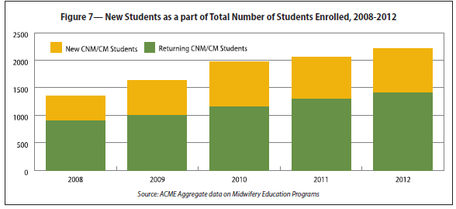
CNM/CM Education: Landscape Today
Notes:
The number of CNM/CM students is increasing

Slide 19
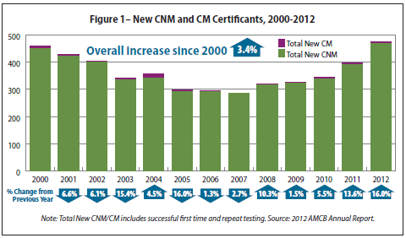
CNM/CM Education: Landscape Today
Notes:
The number of CNM/CM Certificants is increasing.

Slide 20
ACNM 2013 Midwifery Education Trends Report: Issues Identified
The number of qualified applicants exceeds the spaces available in education programs
Programs for bachelor’s prepared non-nurses are often oversubscribed, while a few programs that only accept RNs are undersubscribed
Growth of CM constrained by lack of state licensure (only 5 states authorize CMs to practice)
Unknown how the DNP and increasing tuition levels will affect aspiring midwives

Slide 21
ICM Education Standards and ACME Accreditation
A side by side comparison of the ICM Education Standards & ACME Criteria for Programmatic Accreditation of Midwifery Education Programs was completed in 2013 and did not reveal any significant gaps, although a few minor deficiencies or differences were noted, which are not pertinent in the context of the United States.
Notes:
ACME does not have a criterion that specifies that the midwifery program director has experience with management/administration, nor does ACME take into account national policies related to the midwifery workforce, since they do not exist in the United States. ACME has no specific requirement for written policies related to student and teacher safety. However, policies related to personal safety, universal precautions, required immunizations and background checks are usually incorporated into the department, school, college or university within which the midwifery education program resides. In addition, ACME criteria do not identify specific percentage breakdown in the midwifery curriculum between didactic courses and clinical experiences. ACME criteria do require both types of coursework in the midwifery curriculum in an adequate amount to educate competent midwives.

Slide 22
ICM Essential Competencies & ACNM Core Competencies
A comparison of the ICM Essential Competencies & the ACNM Core Competencies for Basic Midwifery Practice was also undertaken in 2013.
The ACNM Core Competencies include the Essential Competencies and also expand CNM/CM practice to include basic primary care knowledge and skill for the care of women across the lifespan.

Slide 23
References for More Information
Accreditation Commission for Midwifery Education, Criteria for Programmatic Accreditation of Midwifery Education Programs with Instructions for Elaboration & Documentation, October, 2012. Retrieved from http://www.midwife.org/ACME-documents
Accreditation Commission for Midwifery Education, Policies and Procedure Manual, December 2011 with Revisions November, 2012. Retrieved from http://www.midwife.org/ACME-documents
American College of Nurse-Midwives, Position Statement on Midwifery Education, 2009. Retrieved from http://www.midwife.org/ACNM/files/ACNMLibraryData/UPLOADFILENAME/000000000078/Midwifery_Education_7_10.pdf
American College of Nurse-Midwives, Definition of Midwifery and Scope of Practice of Certified Nurse-Midwives and Certified Midwives, 2012. Retrieved from http://www.midwife.org/ACNM/files/ACNMLibraryData/UPLOADFILENAME/000000000266/Definition%20of%20Midwifery%20and%20Scope%20of%20Practice%20of%20CNMs%20and%20CMs%20Feb%202012.pdf

Slide 24
References for More Information
American College of Nurse-Midwives, Core Competencies for Basic Midwifery Practice, 2012. Retrieved from http://www.midwife.org/ACNM/files/ACNMLibraryData/UPLOADFILENAME/000000000050/Core%20Comptencies%20Dec%202012.pdf
International Confederation of Midwives, Essential Competencies for Basic Midwifery Practice, 2010. Retrieved from http://www.internationalmidwives.org/Portals/5/2011/DB%202011/Essential%20Competencies%20ENG.pdf
International Confederation of Midwives, Global Standards for Midwifery Education, 2010. Retrieved from http://www.internationalmidwives.org/Portals/5/2011/DB%202011/MIDWIFERY%20EDUCATION%20PREFACE%20&%20STANDARDS%20ENG.pdf
International Confederation of Midwives, ICM International Definition of the Midwife, June, 2011. Retrieved from http://www.internationalmidwives.org/Portals/5/2011/Definition%20of%20the%20Midwife%20-%202011.pdf

