Slide 1
ACNM: Your Professional Home
Affiliate Information here

Slide 2
A Common Vision
Vision:
Advancing the health and well-being of women and newborns by setting the standard for midwifery excellence.
Mission:
ACNM works to establish midwifery as the standard of care for women. We lead the profession through education, clinical practice, research, and advocacy
Notes:
The vision and mission of ACNM.

Slide 3
Benefits for all members
Subscription to the Journal of Midwifery and Women’s Health
Advocacy at the state and federal level
Annual Meeting registration discount
Support for Clinical Practice Issues
Publications that inform and educate
Opportunities for continuing education
Opportunities to lead or be recognized
Networking Opportunities
Heightened Public Awareness of the Profession
Notes:
ip!

Slide 4
Benefits for Students
Subscription to Journal of Midwifery and Women’s Health, the leading journal of the profession
Greatly reduced dues for students and new midwives
Discounted rates to the Annual meeting
Special events specifically for student members at the Annual Meeting
Membership in this affiliate!
Joining ACNM is the first step you can take in living the profession
Notes:
For a fraction of the cost of membership, students have most of the same benefits as Active Members, but with a few additions.
All ACNM members receive a subscription to The Journal of Midwifery and Women’s Health, the leading journal of the Profession.
But students also receive reduced dues; discounted registration rates to the Annual Meeting; special events at the Annual meeting just for students – and of course a special place in this affiliate’s membership!

Slide 5
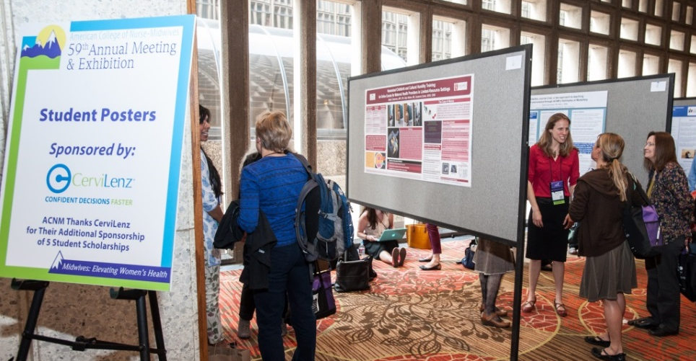
Annual Meeting – the can’t-miss event of the year!
Specific events held for Students:
Lunch with the Board of Directors and ACNM Staff
Student Poster Challenge
Heart of Midwifery
Exam Prep workshop
©Robert Levy Photography
Notes:
The Annual Meeting is the premier education event for all midwives. But there is So. Much. More!
All students are invited to attend a special lunch with the ACNM Board of Directors and ACNM Staff
This is an opportunity to meet the Board, the Foundation and the national office staff.
Student Poster Challenge
Gives students the chance to showcase their research for all members attending the Annual Meeting
Each year, ACNM offers and Exam Prep workshop to help prepare students for the AMCB exam.

Slide 6
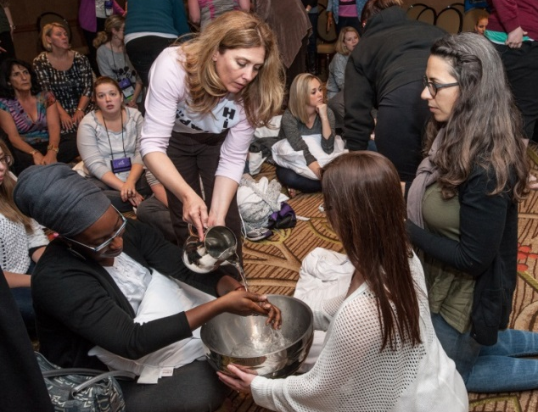
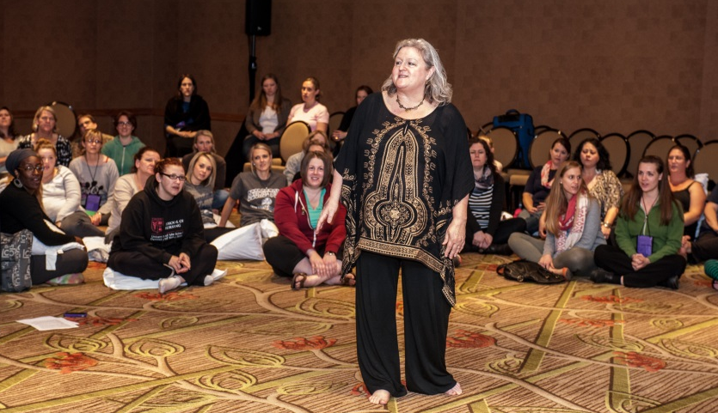
Annual Meeting – The Heart of Midwifery
A time for singing, dancing, storytelling, skits and games to help midwives reconnect to the calling.
Includes a hand-blessing ceremony as students are welcomed into the circle of midwives. There is always a lot of laughter, and a few tears, and inspiration to sustain everyone until next time.
©Robert Levy Photography
Notes:
The Heart of Midwifery is a chance to experience the softer side of midwifery; to remember the calling to midwifery and appreciate each other for our work as midwives

Slide 7
Scholarships and Awards
In 2014 the A.C.N.M. Foundation gave $24,000 in awards to Student Midwives
Basic Midwifery Awards
Midwives of Color-Watson Scholarship
The Edith B. Wonnell CNM Scholarship
A.C.N.M. Foundation Memorial Scholarship
GlaxoSmithKline TUMS Calcium for Life Consumer Health Care Scholarship
Varney Participant Award
Midwifery Legacies Project 20th Century Student Interview Awards
Notes:
Did you know that in 2014 the A.C.N.M. Foundation gave $24,000 in awards? This is a lot of money that can help with the costs of a midwifery education. However, you have to be a member to be considered!

Slide 8
Student Issues Section
Vehicle for student voices
Annual Report given to the membership
Representation from each program
Notes:
The Student Issues section exists to provide a vehicle for student voices. Annually, they present a report to the Board and membership and the Board responds. In the near future, the Student Issues Section will be expanded to include new grads.

Slide 9
Networking: Fellow Students, Other Midwives
eMidwife Discussion Groups
Students
Issue specific
Affiliates
Attend an Affiliate Meeting
Get to know the midwives in your community
Network to help find a job
Notes:
The eMidwife Discussion Groups are the list serves that are available to all members. There are lists for only students; for only affiliate member and issues specific lists, such as homebirth; midwives of color; midwives teaching nurses. But you have to be a member to be a part of the conversations!

Slide 10
Job Search
Midwifejobs.com in the official career center of ACNM
Post resume in searchable database
Allows you to post up to 5 career-related documents
Receive email alerts when new jobs match your criteria
Notes:
www.midwifejobs.com

Slide 11
Get Involved and volunteer!
Expand your professional network
Enhance your own leadership skills
Make an impact on the profession
Volunteers make ACNM a vibrant organization
ACNM has 4 Divisions
20 Sections under the 4 Divisions
8 Committees
7 Task Forces
7 Caucuses
Notes:
Much of the work of ACNM is accomplished through volunteer structure of Divisions, Sections, Committees, Task Forces and Caucuses. Volunteering for either a national committee or an affiliate committee will give you the opportunity to expand your own professional network; to enhance your own leadership skills. But serving on a committee and being involved also helps the profession of midwifery. Volunteers make ACNM a vibrant organization but also make a difference.
AFFILIATES: You are welcome to put in affiliate-specific information

Slide 12
Get Social!
Join the conversations:
Facebook: /ACNMmidwives
Twitter: /ACNMmidwives
Pinterest:/acnmmidwives
YouTube: ACNMWEB
ACNM Blog (Midwife Connection): midwife.org/blog
Notes:
ACNM has many different Social Media channels to engage members. INCLUDE INFORMATION ABOUT THE AFFILIATE SOCIAL MEDIA OR WEB PRESCENCE

Slide 13
Affiliate Update

Slide 14
Affiliate Update

Slide 15
Affiliate Events

Slide 16
Affiliate Involvement

Slide 17
What Students are saying…
“The Journal became my go-to subway/airplane/coffee shop reading - it started conversations about midwifery that never would have happened otherwise. Quickly I learned that ACNM student membership granted me access to an experience that was much richer than just current midwifery research.”
“I have enjoyed being a member of ACNM in that I had access to see midwifery from a larger perspective and see the impact that all the midwives across the country have on women's healthcare.”
Are you ready to begin living the profession?

