Slide 1
ACCREDITATION COMMISSION
FOR MIDWIFERY EDUCATION
SITE VISITOR WORKSHOP
May 14, 2014
Diane Boyer, CNM, PhD, facnm
Chair, ACME Board of Review
Melissa avery, PhD, CNM, FACNM, FAAN
Site visitor coordinator
ACME Board of commissioners

Slide 2
AGENDA
I. Introduction, USDE issues
II. Review of confidentiality policy
III. Update on components of the visit
A. Before the visit
B. The Site Visitor Report
C. Glossary and New Definitions
D. New criteria
E. Distance Education
F. Student complaints
IV. Challenging situations and other issues
V. Practice—mock SER and SVR
VI. Questions and summary

Slide 3
BEFORE THE VISIT
Review Sections V. E, F & G in the ACME Policies and Procedures Manual
Read the Self-Evaluation Report (SER) within 2 weeks after you receive it.
The staff will review the SER for formatting, but are not able to evaluate content.
After both Site Visitors (SVs) have read the SER, they should consult with each other within a week and compile a list of any omissions or errors they identify.
If you see major omissions or errors in the SER, consult the Board of Review (BOR) Chair. If the problem is too severe, the SER may need to be sent back for re-writing and the site visit rescheduled, which is why it is important to read the SER soon after you get it.

Slide 4
BEFORE THE VISIT
If the omissions or errors are relatively minor, it is permissible for the Senior SV to contact the Program Director (PD) before the visit to inform her/him of additional information that will be required. Copy the BOR Chair on any such communications.
For example, if a table is confusing or has missing information, tell the PD what will be required. They will have time to make the necessary changes or compile additional information before the visit.

Slide 5
BEFORE THE VISIT
The PD should contact the Senior SV no later than 4 weeks before the visit with a draft schedule.
Review the draft schedule as soon as possible, so the PD will have sufficient time to make any changes that are necessary.
Frequently the draft schedule will not have sufficient time scheduled for the faculty and student interviews. Each should be at least an hour.
Half-hour interviews should be sufficient for administrators.

Slide 6
SITE VISITOR REPORT (SVR)
After the new check-off format for the SVR was developed, some site visitors began using mostly the check-off boxes when writing the report, and included very little narrative.
USDE requirements are now more stringent, and require a listing of the evidence that is used to verify that the criterion has been met.
The SVs are the eyes and ears of the BOR. If the SVs are confused by something in the SER, then the BOR reviewers will be also. The SVs should try to answer as many of those questions as possible. The ideal SVR would be so complete that the BOR reviewers, after reading it, the SER, and any supplemental materials the SVs or PD sends, would have no additional questions they need to ask the PD in order to be satisfied that the criterion has been met.

Slide 7
SITE VISITOR REPORT
The first option listed under each criterion in the SVR format should read, “Verified the evidence as stated in the SER.” It does not say, “verified with the SER.” In the SER, the program is presenting information that they say is evidence that a criterion has been met. The job of the SVs is to find evidence from a source other than the SER that verifies what has been presented in the SER.
Some SVs are interpreting “Verified the evidence as stated in the SER” as “Verified with the evidence in the SER,” quite a different thing. You don’t verify what is in the SER by stating you have verified it with itself. You need verification from another source, such as looking at the Student Handbook yourself.
What this response in the SVR means is that the SER states that the evidence to meet a criterion, say the non-discrimination statement, is in the Student Handbook, p.2. What the SVs are then doing is verifying that what the SER says is correct—they look at p. 2 of the Student Handbook, and see the non-discrimination statement. No additional evidence is needed.
In the SVR you would check the “Verified the evidence as stated in the SER” box, and under “Comments” write something like, “Student Handbook, p. 2).

Slide 8
SITE VISITOR REPORT
The response to most criteria will be, “Verified the evidence as stated in the SER and with additional evidence.”
The “Comments” area should list the evidence you found to verify what was in the SER and then the additional evidence you found.
You could write a paragraph or list the evidence in a bullet format.
Including quotes from people interviewed like students and the dean enriches the report and is helpful to the BOR.

Slide 9
SITE VISITOR REPORT
If you check, “Not verified” under a criterion, the “Comments” section must include what information was lacking and why you were not able to verify that the criterion had been met.

Slide 10
GLOSSARY AND NEW DEFINITIONS
Several new definitions were added in the last revision of the Criteria.
Academic Institution
Board of Commissioners
Board of Directors
Certificate
Correspondence Education (modified)
National Office
Probation
Professional Midwife
Program
Site Visitor Panel
Teach-out Agreement
Warning
Withdrawal of Pre/Accreditation

Slide 11
GLOSSARY AND NEW DEFINITIONS
It is important to review the Glossary before reading the SER.
Note particularly the new definition of “Program.”
PDs have been asked to use the ACME definitions in writing the SER or supply a table of their definitions with ACME equivalents.
However, not all will have done this, so if there is confusion about terms and definitions they are using, please clarify those and include your clarification in the SVR. Remember, if you are confused by something in the SER, the BOR will be also.

Slide 12
DEFINITIONS ESPECIALLY IMPORTANT IN THE SER
Midwifery Program Faculty
Core Faculty
All Faculty

Slide 13
MIDWIFERY PROGRAM FACULTY
“All certified midwives and faculty of other disciplines who teach and evaluate midwifery students. This includes faculty members with primarily or exclusively clinical teaching responsibilities.”
This includes:
Core Faculty
Clinical Preceptors
Faculty who are not midwives who may teach a course such as Pathophysiology or Research.

Slide 14
CORE FACULTY
“Faculty, including midwives and others, as defined by the program, who are directly responsible for curriculum design, implementation, and evaluation of the midwifery program.”
The program identifies who is “Core” using the above definition. It usually is not everyone who teaches any course midwifery students take, but those faculty responsible for overall program design and evaluation.

Slide 15
ALL FACULTY
“Faculty who teach midwifery students in any setting.”
This would include Midwifery Program Faculty and all guest or occasional faculty members who may give a lecture or conduct a seminar. It is not necessary to include information about these guest faculty members in the faculty tables in the SER.

Slide 16
FACULTY TABLES IN THE SER
Three faculty tables are required in the SER. Table formats are included in the Appendices of the Criteria.
Table II.B. Faculty as Detailed in Criterion II.B (Midwifery Program Faculty)
Table II.C.1. Courses with Core Competency Content
which includes faculty who taught them in the designated SER year
Table II.C.2. All Faculty who Provide Clinical Supervision
Sometimes the PD has not followed the directions in writing these tables. If this happens, the SVs must clarify in the SVR, and the PD should provide corrected tables as necessary. Information in these tables should be only for the SER year that the program has designated.

Slide 17
FACULTY TABLES IN THE SER
TABLE II B
FACULTY AS DETAILED IN CRITERION II B
tt
Faculty Name Surname, First Name | Category Core or Midwifery Faculty | Type of Specialty Certification or Specific Expertise if Core Faculty | Highest Earned Degree | Faculty Appointment (e.g. Associate Professor)
This table should include all faculty who meet the definition of Midwifery Program Faculty. The instructions say the table should begin with Core Faculty (midwives and others) followed by clinical faculty (midwives and others). Although the table doesn’t require it, it is very helpful to the BOR to ask the PD for the percent time that each Core Faculty member devotes to the midwifery program, if they haven’t included that information in the SER.

Slide 18
FACULTY TABLES IN THE SER
TABLE II C 2
ALL FACULTY WHO PROVIDE CLINICAL SUPERVISION AS DETAILED IN CRITERION II C 2
Faculty by Name and Credential (Surname first) | Clinical Site in Which Faculty Teach | Type of Clinical Area (e.g. AP)
Basic information (certification, degree, etc. ) about all of the faculty listed in this table should be listed in Table II.B. This table asks for different information than Table II.B.

Slide 19
TABLE II C 2
ALL FACULTY WHO PROVIDE CLINICAL SUPERVISION AS DETAILED IN CRITERION II C 2
Instructions for this table say:
“In the table, include all faculty who provide clinical supervision. For clinical courses/content taught by midwifery program faculty, describe the process for assuring the training of safe, competent midwives.”
The last part of this instruction is often overlooked. In the SER, the program should have provided a brief description of how clinical faculty are chosen, how they’re prepared for and supported in their teaching, and the extent to which they participate in assessing whether the student has reached competency. If this information is missing from the SER, the PD should provide it in an addendum to the SVR or send it later to ACME.

Slide 20
FACULTY TABLES IN THE SER
Table II.C.1
Courses with Core Competency Content
Course Number | Course Name | Date/Semester Taught | Faculty by Name
Note that faculty other than Core Faculty may teach courses with Core Competency content.

Slide 21
Another definition that may be confusing:
“Certified Midwife” as used throughout the Criteria document refers to both CNMs and CMs.

Slide 22
Instructions for Title Page and Program Overview
Note that the form given in Appendix A of the Programmatic Criteria for the Title Page and Program Overview has two sides:
The front side says “Title Page.”
The back side has a table titled “Program or Programs.”
This table is sometimes overlooked, but contains important information to give the program overview. If the SER does not contain this table, the PD should be asked to provide it.

Slide 23
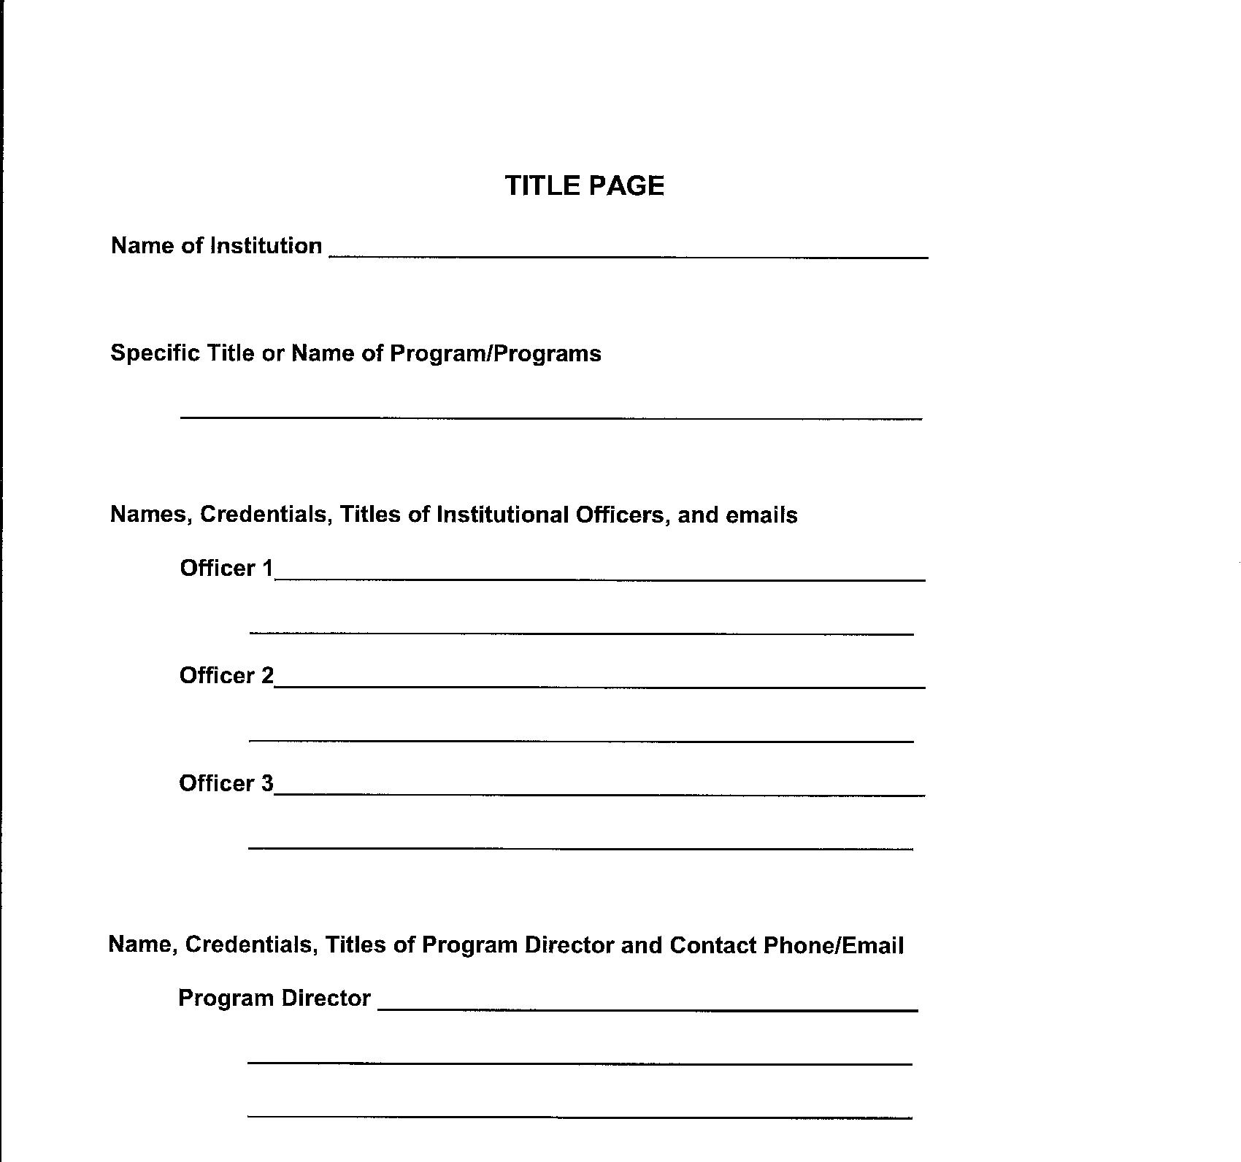

Slide 24
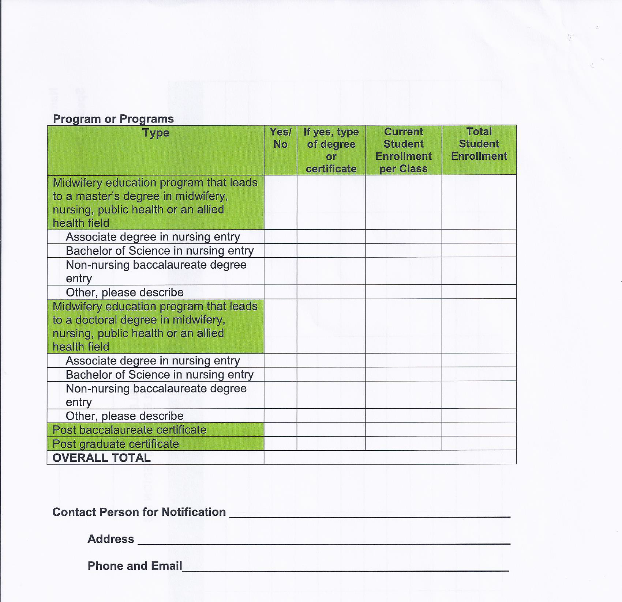

Slide 25
NEW CRITERIA
Several new criteria were added in the 2013 revisions.

Slide 26
New Criterion III.B.
III.B. Recruitment materials and processes accurately represent the program practices and policies.
In the SER describe recruitment materials and processes and how they accurately represent the program.
In the Exhibits provide samples of recruitment materials and documentation of recruitment processes.

Slide 27
New Criterion IV. D.
D. The midwifery program has standards for student preparation for or exemption from didactic course work.
D.1. Asks for a description of the criteria used to exempt students from didactic coursework.
D.2. Asks for documentation of how the program requires students to meet the criteria described in D.1.
Criterion IV.C., which was in the last edition of the Criteria as well as this one, asks for the same information about clinical coursework.
C. The midwifery program has standards for student preparation for or exemption from clinical course work and clinical experience.
However, the way these criteria are worded can be confusing.

Slide 28
New Criterion IV. D.
D. The midwifery program has standards for student preparation for or exemption from didactic course work. (No narrative required.)
D.1. The midwifery program has established criteria which students must meet prior to (prerequisite) or concomitantly with (corequisite) enrolling, receiving transfer credit for, or being exempted from midwifery didactic coursework
What does this mean? D.1. requires that programs have standards or criteria for:
Prerequisites for enrolling in didactic courses or courses which must be taken at the same time;
Requirements which students must meet before receiving transfer credit for courses in the program;
Requirements which students must meet before being exempted from didactic coursework.
The SER should address all three of these.

Slide 29
New Criterion IV. D.
D.2. The midwifery program ensures that students meet the program’s established prerequisite or corequisite criteria prior to or concomitantly with enrolling in, or being exempted from, midwifery didactic coursework.
D.1. requires that the program have criteria or standards. D.2. requires that they demonstrate that they have applied those criteria or standards.

Slide 30
New Criterion VI.A.2
A.2. The passing rate for first takers of the national certification examination is at least 85%. Programs develop effective plans to bring the pass rate to 85% if it drops below that point.
This information has been required on the Annual Monitoring Reports, but the USDE wants accrediting agencies to establish benchmarks for the programs it accredits.
The SER should contain pass rates for the past three years, both first-time and repeats.
If a different pass rate is used for informing the public, e.g. cumulative pass rate rather than first-time on their website, they should explain that in the SER.
For any first-time pass rates <85% in the past three years, the SER should contain a description of actions already taken and/or planned to remedy the situation.

Slide 31
A Concern about Program Objectives/Outcomes
IV.A.2. The midwifery program’s purpose/mission and objectives/outcomes are clearly stated and are consistent with the midwifery program philosophy.
AND
A.1. The midwifery program philosophy is consistent with:
A.1.a. The philosophy of the ACNM.
ACME does not specify for programs what their program objectives/outcomes must be.
However, to be consistent with A.1.a., they should be specific to midwifery and not so generic that they could apply to any nurse practitioner program.
The BOR has seen an example of generic program objectives recently. There was no mention of midwifery or mothers and babies. If you see this when doing a SV, be sure to question the PD and faculty about how those objectives are consistent with their philosophy, which should be midwifery-focused.

Slide 32
Also about Program Objectives/Outcomes
If there is more than one program for midwives leading to different credentials, then there should be a separate Purpose/Mission and Objectives/Outcomes for each. The BOR has seen examples of programs that have converted from a master’s to a DNP, but the purpose and objectives are exactly the same.
There may be considerable overlap between Objectives/Outcomes for different programs, e.g. master’s and doctorate, but there should be some differences, otherwise why do they lead to different degrees?
The same is true for the purpose/mission of the different programs.

Slide 33
Clarification of Criterion IV.G.
G. The curriculum conforms to state or nationally recognized guidelines for the program/s educational level/s: certificate, master’s degree, and/or doctoral degree.
The instructions say:
Identify the guidelines used and provide the URL if available. Explain how the curriculum conforms to guidelines for the program/s educational level/s. If the program culminates in a practice doctorate such as, but not limited to, a DNP or DMP degree, describe how the program conforms to the competencies identified in the ACNM document , The Practice Doctorate in Midwifery.
*Note the new requirement that practice doctorate programs must document how they meet the ACNM practice doctorate competencies.

Slide 34
Clarification of Criterion IV.G.
Programs have been interpreting this criterion in different ways.
The focus should be on what, beyond the basic midwifery competencies, makes the program a master’s, doctoral, basic certificate or post-graduate certificate program.
There are professional guidelines for various types of programs, e.g. those developed by ACNM or AACN. Some states and universities have standards for various types of educational programs.

Slide 35
Clarification of Criterion IV.G.
The SER should list what guidelines have been used and how the program conforms to those guidelines. This can be done in narrative or table format, and does not need to be as detailed as the Core Competencies table, but should provide sufficient examples to provide adequate documentation that the guidelines are being implemented in the program.
If there is more than one program, e.g. a master’s program, a doctoral program and a post-graduate certificate, they must provide the guidelines for each of them.
The SER should contain the URLs for the complete text of the guidelines, or hard copies should be in the Exhibits so SVs can evaluate whether they are being implemented in the curriculum.

Slide 36
DISTANCE EDUCATION
The USDE emphasizes that accrediting agencies must provide oversight of programs that they accredit to ensure that those using distance modalities to deliver the curriculum have equal access to program resources as on-campus students.
Those resources include laboratory, clinical, clinical simulation, computer, and library services.
SVs should also question how distance students have access to support services such as advising, counseling, and writing assistance, as well as how students with learning and other disabilities are accommodated and supported.
Resources should be available and accessible.

Slide 37
DISTANCE EDUCATION
At least one SV on a team that site visits a distance education program should have familiarity with distance methodologies.
When the Senior SV is discussing the site visit schedule with the PD, she/he should ask how they plan to provide for the interview of students during the site visit to ensure that a representative sample of students will be available to be interviewed.

Slide 38
Student Complaints
The USDE is also concerned about how student complaints are addressed in order to identify possible problems with a program’s compliance with any accreditation criteria.
Criterion III: Students, F. Student rights and responsibilities consistent with institution policy are available in written form, and students are notified where the policies may be found. This includes:
F.3.Clearly defined mechanisms for consideration of grievances, complaints or appeals.
SER Instructions: Describe the mechanisms for addressing grievances, complaints or appeals and how students are apprised of these mechanisms. Identify the location of the process in formal documents.
Exhibit Instructions: Document student access to the mechanisms. As applicable, provide examples of grievances, complaints or appeals from the past three years.

Slide 39
Student Complaints: The SV Role
SVs should probe the program’s handling of:
  students’ suggestions for improvement of the program,
  informal or formal complaints, and
  appeals of grades or progression decisions.
Probing should include questions for students, faculty, and administrators that cover the past 3 years of possible complaints. SVs should read all written evidence of a complaint or appeal. SVs will document their questioning and review of any documents provided.

Slide 40
OTHER ISSUES
When possible, supply at least two sources of verification of evidence, e.g. 1) Review of faculty minutes, 2-6-12; 2) Interview with students.
When verifying information such as clinical contracts or faculty credentials, indicate whether you have reviewed 100% or a sampling [review guidelines for sampling in the ACME Policies & Procedures Manual, V. E. 12. 1)-5)].
If additional materials are being submitted with the SVR, please provide a list of them at the beginning of the report.
If the program plans to submit additional materials within the required timeframe after the site visit, also provide a list of those at the beginning of the report.

Slide 41
CHALLENGING SITUATIONS DURING SITE VISITS
EXAMPLES TO SHARE?
If any issues arise during the course of the site visit that require advice, be sure to call the ACME Chair or the Chair of the BOR.

Slide 42
PRACTICE: MOCK SER AND SVR
SEE HANDOUT
Area selected was Criterion VI. Assessment and Outcomes
Criteria A, A.1.a-c
The focus is on the program setting its own goals.
ACME needs to evaluate whether the goals are appropriate to the mission/purpose of the program and if it is meeting its own goals.

Slide 43
MOCK SER AND SVR
Read the response to each criterion in the mock SER.
Review the Instructions in the criteria document
Does the SER include everything asked for in the Instructions?
Using the SV Worksheet, note what evidence you need to see in the Exhibits or from interviews to verify the information presented in the SER. If there is missing information in the SER, note that and where you need to obtain the information.

Slide 44
REMEMBER!
You are the eyes and ears of the BOR. The BOR depends on you to be complete in your verification, clarification and amplification of information to provide documentation that criteria are being met in order for the BOR to make fair and correct accreditation decisions.

Slide 45
Board of Review Worksheet
ACME Program Accreditation Criterion VI: Assessment and Outcomes
Criterion VI: Assessment and Outcomes | Instructions for Elaboration in the SER | Criterion Met Yes No | **Evidence to Support Criterion Met OR Additional Evidence that is Required** | Additional Comment or Recommen-dations

Slide 46
THANK YOU!
Thank you for using your valuable time and expertise to support midwifery education by being a site visitor.

