Slide 1
Orientation to the Accreditation Commission for Midwifery Education ACME
May 14, 2014
Susan Stone, DNSc, CNM, FACNM, FAAN
Chair Board of Commissioners
Diane Boyer, PhD, CNM, FACNM
Chair, Board of Review

Slide 2
What is ACME?
An autonomous commission of the American College of Nurse-Midwives
Recognized by the United States Department of Education (USDE)
Purpose is to plan, implement, evaluate and monitor the pre/accreditation of programs that offer midwifery education.

Slide 3
What is Accreditation?
A voluntary quality assurance activity conducted jointly by ACME and the educational institution which combines self-assessment and peer review.

Slide 4
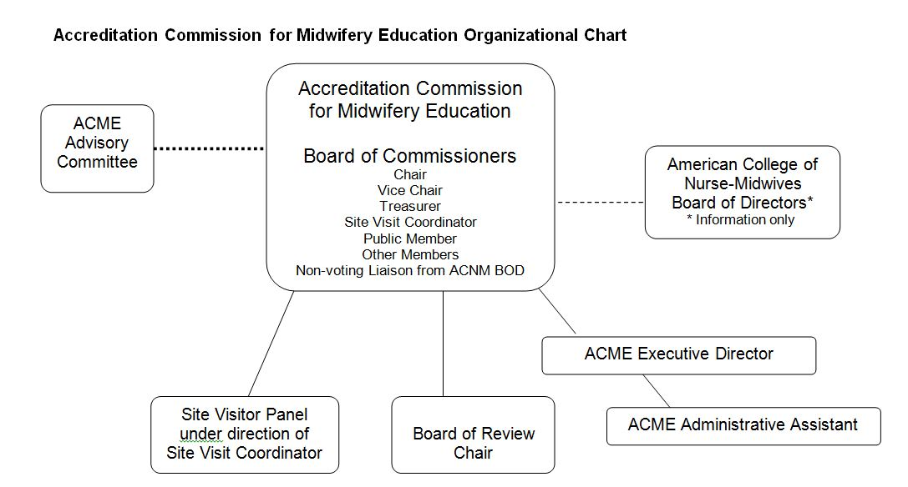
Organizational Structure

Slide 5
US Department of Education
Regulates accreditation in the US
Every five years ACME submits a compliance report.
Upon successfully meeting all criteria, ACME is recognized by USDE as an accrediting agency.
Requirements have become increasingly stringent in recent years

Slide 6
Many Government Efforts to Improve Education
Concerns over “diploma mills”
Concerns about distance education
Concerns over the expense of higher education
Concerns over transparency about price, study plans, completion rates (Only 58 percent of full-time students who began college in 2004 earned a four-year degree within six years.)

Slide 7
FACT SHEET on the President’s Plan to Make College More Affordable: A Better Bargain for the Middle Class
http://www.whitehouse.gov/the-press-office/2013/08/22/fact-sheet-president-s-plan-make-college-more-affordable-better-bargain-

Slide 8
Paying for Performance President’s Agenda
Tie financial aid to college performance, starting with publishing new college ratings before the 2015 school year.
Challenge states to fund public colleges based on performance.
Hold students and colleges receiving student aid responsible for making progress toward a degree.

Slide 9
Promoting Innovation and Competition President’s Agenda:
Challenge colleges to offer students a greater range of affordable, high-quality options than they do today.
Give consumers clear, transparent information on college performance to help them make the decisions that work best for them.
Encourage innovation by stripping away unnecessary regulations.

Slide 10
Ensuring that Student Debt Remains Affordable President’s Agenda
Help ensure borrowers can afford their federal student loan debt by allowing all borrowers to cap their payments at 10 percent of their monthly income.
Reach out to struggling borrowers to ensure that they are aware of the flexible options available to help them to repay their debt.

Slide 11
ACME: Current Scope of Recognition by USDE
The accreditation and accreditation of basic certificate, basic graduate nurse-midwifery education, direct entry midwifery and pre-certification nurse-midwifery education programs including those programs that offer distance education.

Slide 12
ACME Accredits Various Types of Programs
Programs might include but are not limited to:
Associate degree or baccalaureate degree to masters degree program in nurse-midwifery or midwifery
Post-baccalaureate certificate
A midwifery education program that leads to a masters degree in midwifery, nursing, public health or an allied health field
Post-graduate certificate
A midwifery education program that leads to a doctoral degree

Slide 13
Three Types of Reviews
Pre-Accreditation – new programs prior to the admission of students
Initial Accreditation – First review and consideration as it is being implemented. Occurs as the program is about to graduate its first class
Continuing accreditation – Periodic complete review including Self Evaluation Report, Site Visit and complete review
Annual Monitoring Report – Programs are required to annually submit requested information. These reports are reviewed in detail and could result in various actions.

Slide 14
Two Core Documents
ACME Policy and Procedure Manual
ACME Criteria for Programmatic Accreditation of Midwifery Education Programs with Instructions for Elaboration and Documentation

Slide 15
Definitions
Series of definitions in the introduction to both the PP Manual and the Criteria Document
Critical to read them and refer to them often while completing a Site Evaluation Report (SER).
For example: the term certified midwife is used throughout the documents to include both CNMs and CMs.

Slide 16
NEW DEFINITION: “PROGRAM”
As defined by the US Department of Education, “a postsecondary educational program offered by an institution of higher education that leads to an academic or professional degree, certificate, or other recognized educational credential.” [34 CFR §602.3 Definitions]

Slide 17
Interpretation
If you have a MSN program and a post masters certificate program, these are two different programs.
If you have a CNM program and a CM program, these are two different programs (they lead to a different credential).

Slide 18
Companion Program
ACME created this term to facilitate the review of separate but closely related programs within one institution.

Slide 19
Companion Program
A program leading to a different credential than the one
currently offered within an academic unit that is designed
to augment the midwifery education options for students
and mesh with the existing ACME accredited program.
Some of the elements may be similar for the existing and
companion programs, such as institutional
administration, academic facilities, and the like. Students
may share a number of the same classes.
However, the companion program leading to its separate credential will have its own objectives, completion requirements and its own curricular path.
Faculty, clinical sites, library resources, evaluation and other aspects of the companion program may be added or changed as needed from the existing ACME accredited program.
ACME Policy Procedure Manual

Slide 20
Companion Program
Requires one Self Evaluation Report (SER) which clearly addresses both programs and their similarities and differences.

Slide 21
Preparing for (Re)Accreditation
Review P&P manual carefully—see Appendix G for deadlines
Initiate the process and request a site visit
Plan a timeline for SER and site visit with plenty of time for input from all parties—faculty, administrators, students

Slide 22
Preparing for (Re)Accreditation
Writing the SER
See Appendix F: Instructions for Preparation of Reports
Carefully read and follow all instructions in the Criteria for Programmatic Accreditation
If there are any questions, consult the Executive Director.

Slide 23
Instructions for Title Page and Program Overview
Note that the form given in Appendix A for the Title Page and Program Overview has two sides:
The front side says “Title Page.”
The back side has a table titled “Program or Programs.”
This table is sometimes overlooked, but contains important information to give the program overview.

Slide 24
TITLE PAGE
Name of Institution ______________________________________________
Specific Title or Name of Program/Programs
______________________________________________
Names, Credentials, Titles of Institutional Officers, and emails
Officer1____________________________________
Officer 2____________________________________
Officer 3____________________________________
Name, Credentials, Titles of Program Director and Contact Phone/Email____________________________________
Program Director_____________________________
_______________________________________________

Slide 25
Program or Programs
Type | Yes/ No | If yes, type of degree or certificate | Current Student Enrollment per Class | Total Student Enrollment
Midwifery education program that leads to a master’s degree in midwifery, nursing, public health or an allied health field
Associate degree in nursing entry
Bachelor of Science in nursing entry
Non-nursing baccalaureate degree entry
Other, please describe
Midwifery education program that leads to a doctoral degree in midwifery, nursing, public health or an allied health field
Associate degree in nursing entry
Bachelor of Science in nursing entry
Non-nursing baccalaureate degree entry
Other, please describe
Post baccalaureate certificate
Post graduate certificate
OVERALL TOTAL
Contact Person for Notification _____________________________________
Address ________________________________________________________
Phone and Email _________________________________________________

Slide 26
Preparing for (Re)Accreditation
Preparing for the site visit
Review Site Visit section in the Policies and Procedures Manual
Follow all instructions for the organization of the Exhibits in and for the content of the Exhibits in the Criteria for Programmatic Accreditation.
It is helpful to have sections of the Exhibits organized in portable boxes for the convenience of site visitors.

Slide 27
ACME: Components of the Evaluation
Criteria for Programmatic Accreditation of Midwifery Education Programs
Criterion I Organization and Administration
Criterion II Faculty and Faculty Organization
Criterion III Students
Criterion IV Curriculum and Student Learning
Criterion V Resources
Criterion VI Assessment and Outcomes

Slide 28
Criterion I Organization and Administration
Describe how the program is organized..must reside within or be affiliated with an accredited institution of higher learning.
Describe the budget process
Each program is a definable entity distinguishable from other education programs.
There is a program director who is a midwife
Public transparency and accuracy of program details (ex. degree offered, tuition, transfer of credit, admission, graduation policies)

Slide 29
Criterion II Faculty and Faculty Organization
In this section, you will describe all things pertaining to faculty.
How they are recruited?
Required qualifications.
How they are credentialed
How do you determine competency to teach what they teach?
Responsibilities
Resources for faculty
Scholarly activities
Etc. as detailed in ACME Criteria

Slide 30
Faculty Definitions
All Faculty
Core Faculty
Midwifery Program Faculty

Slide 31
MIDWIFERY PROGRAM FACULTY
“All certified midwives and faculty of other disciplines who teach and evaluate midwifery students. This includes faculty members with primarily or exclusively clinical teaching responsibilities.”
This includes:
Core Faculty
Clinical Preceptors
Faculty who are not midwives who may teach a course such as Pathophysiology or Research.

Slide 32
CORE FACULTY
“Faculty, including midwives and others, as defined by the program, who are directly responsible for curriculum design, implementation, and evaluation of the midwifery program.”
This includes only faculty who are responsible for overall program design and evaluation.

Slide 33
ALL FACULTY
“Faculty who teach midwifery students in any setting.”
This would include Midwifery Program Faculty and all guest or occasional faculty members who may give a lecture or conduct a seminar. It is not necessary to include information about these guest faculty members in the faculty tables in the SER.

Slide 34
FACULTY TABLES IN THE SER
Three faculty tables are required in the SER. Table formats are included in the Appendices of the Criteria.
Table II.B. All Midwifery Program Faculty
Table II.C.1. Courses with Core Competency Content which includes faculty who taught them in the designated SER year
Table II.C.2. All Faculty who Provide Clinical Supervision

Slide 35
FACULTY TABLES IN THE SER
Although the instructions say these three tables may be combined, it is easier and clearer for the reader if three separate tables are submitted.

Slide 36
FACULTY TABLES IN THE SER
TABLE II B
FACULTY AS DETAILED IN CRITERION II B
tt
Faculty Name Surname, First Name | Category Core or Midwifery Faculty | Type of Specialty Certification or Specific Expertise if Core Faculty | Highest Earned Degree | Faculty Appointment (e.g. Associate Professor)
This table should include all faculty who meet the definition of Midwifery Program Faculty. The instructions say the table should begin with Core Faculty (midwives and others) followed by clinical faculty (midwives and others).

Slide 37
FACULTY TABLES IN THE SER
TABLE II C 2
ALL FACULTY WHO PROVIDE CLINICAL SUPERVISION AS DETAILED IN CRITERION II C 2
Faculty by Name and Credential (Surname first) | Clinical Site in Which Faculty Teach | Type of Clinical Area (e.g. AP)
Basic information (certification, degree, etc. ) about all of the faculty listed in this table should be listed in Table II.B. This table asks for different information than Table II.B.

Slide 38
TABLE II C 2 ALL FACULTY WHO PROVIDE CLINICAL SUPERVISION AS DETAILED IN CRITERION II C 2
Instructions for this table say:
“In the table, include all faculty who provide clinical supervision. For clinical courses/content taught by midwifery program faculty, describe the process for assuring the training of safe, competent midwives.”
The last part of this instruction is often overlooked. Provide a brief description of how clinical faculty are chosen, how they’re prepared for and supported in their teaching, and the extent to which they participate in assessing whether the student has reached competency.

Slide 39
FACULTY TABLES IN THE SER
Table II.C.1
Courses with Core Competency Content
Course Number | Course Name | Date/Semester Taught | Faculty by Name

Slide 40
Criterion III Students
All things students:
Key words, transparency, support , evaluation
Rights and responsibilities
Opportunities for involvement and participation
Grievances
Access to resources

Slide 41
Criterion IV Curriculum and Student Learning
Curriculum is based on:
A statement of philosophy
A statement of purpose/mission
A statement of objectives and outcomes
Must describe how the midwifery program philosophy is congruent with the philosophy of ACNM, the philosophy of the institution, and if applicable the academic unit in which it resides.

Slide 42
Also about Program Objectives/Outcomes
If you have more than one program for midwives leading to different credentials, then you should have separate Objectives/Outcomes for each.
There may be considerable overlap between Objectives/Outcomes for different programs, e.g. master’s and doctorate, but there should be some differences.
The same is true for the purpose/mission of the different programs.

Slide 43
Must Demonstrate that the Curriculum is Based on these Key Documents
Core Competencies for Basic Midwifery Practice
ACNM Standards for the Practice of Midwifery

Slide 44
E. 4. The program ensures that graduates will have achieved competence.
Explain how the program defines competence.
Explain how the program assesses competence and intervenes to help students who are having difficulty reaching academic or clinical competence.

Slide 45
E. 4.a. The program provides students with the necessary clinical experiences to achieve the objectives/outcomes of the program.
Explain the breadth and depth of clinical experiences used by the program to achieve
program objectives/outcomes.
Clinical experiences are primarily direct patient contacts which may be supplemented by such strategies as simulation, role play, pelvic models, and emerging technologies.

Slide 46
IV. G The curriculum conforms to state or nationally recognized guidelines for the program/s educational level/s: certificate, master’s degree, and/or doctoral degree.
Identify the guidelines used and provide the URL if available. Explain how the curriculum conforms to guidelines for the program/s educational level/s.
Examples: ACNM Practice Doctorate in Midwifery; AACN Masters Essentials in Nursing; new document is being developed by ACNM Task Force describing Competencies Associated with a Masters in Midwifery.

Slide 47
Criterion V Resources
Describe adequate number of staff, faculty, and physical facilities
Describe learning resources including simulation labs, libraries etc.

Slide 48
Criterion VI Assessment and Outcomes
Every program must have an assessment or evaluation plan that evaluates progress in meeting the mission and objectives
Must include ongoing assessment data such as enrollment, graduation and attrition rates
A program will also identify their own objectives based on their mission for example, a certain percentage of minority graduates and enrollment from a certain geographic region (rural, urban, underserved)

Slide 49
AMCB Pass Rates Must Be Maintained at 85% or above
VI.A.2 Provide the most recent three years of data available from the AMCB. Include all candidates, 1st time pass rate, and repeat pass rate.
If a different pass rate is used for informing the public, explain how that pass rate is calculated.
Describe actions taken, and their results, or actions planned for the immediate future, to address pass rates of less than 85% that have occurred any time in the past three years.
Programs with pass rates less than 85% risk accreditation actions such as warning.

Slide 50
Data Must Be Publicly Available
Data to be measured and publicized include graduation data for full and part-time students
Certification pass rates
Any additional data related to your particular mission and objectives.

Slide 51
Faculty Evaluation
All faculty evaluated annually based on:
Didactic competence
Clinical competence
Currency of knowledge
Non-discriminatory, respectful approach to students, colleagues and patients in keeping with the ACNM Code of Ethics

Slide 52
Assessment of Clinical Experiences
Tell us how the clinical experiences enable the student to achieve clinical competence
How is that evaluated?
Must be a current contract for each site, how is that evaluated and assured.

Slide 53
Annual Monitoring Report (AMR) Expectations
This is your annual program review
Plan for timely submission.
Carefully collect data throughout each year.
The section on student numbers and other student information was changed to get more detailed information as required by the USDE.
Review criteria regularly to assure always up to date.
This is an annual review that could result in requests for more information, and even adverse actions such as being placed on warning etc.

Slide 54
Changing Criteria
When criteria are changed you will be notified by letter and email
You are responsible to meet the current criteria.

Slide 55
Questions?

