Slide 1
Marketplaces and the Affordable Care Act
What Midwives and their Patients Need to Know
November 4, 2013

Slide 2
Agenda
Introduction
  Ginger Breedlove, PhD, CNM, APRN, FACNM
  President of the ACNM Board of Directors
Nurses and the Affordable Care Act: Improving the Nation’s Health
  Mary Wakefield, PhD, RN, Administrator of the Health Resources and Services Administration
Overview of Medicaid Expansion and the Health Insurance Marketplaces
  Jesse Bushman, ACNM Director of Advocacy and Government Affairs
Questions

Slide 3
Introduction
Ginger Breedlove, PhD, CNM, APRN, FACNM
President of ACNM’s Board of Directors

Slide 4
Nurses and the Affordable Care Act:
Improving the Nation’s Health
Mary Wakefield, Ph.D., R.N.
Administrator
Health Resources and Services Administration
U.S. Department of Health and Human Services

Slide 5

National Snapshot
41 Million Eligible Uninsured
19 Million Women
17.8 Million
18-35 years old
5

Slide 6

ACA Investments in
HRSA Programs to Support Nurses
HRSA’s Health Center Network employs ~18,000 nurses (up 4,500 since 2009) at 9,000 sites serving more than 21 million people nationwide
The National Health Service Corps (NHSC), a scholarship and loan repayment program for clinicians working in underserved communities, has more than doubled from 3,600 clinicians in 2008 to nearly 8,900 today, and includes
~1,600 nurses
The ACA directed $15 million to Nurse-Managed Health Clinics run by advanced practice nurses and affiliated with schools of nursing
NHSC Nurses
The Maternal, Infant and Early Childhood Home Visiting Program employs about 500 nurses and serves thousands of families across all 50 states
6

Slide 7

ACA Accomplishments
3 million 18 to 26 year olds are covered by their parents’ insurance plans
Women’s preventive health care services (well-women visits, domestic violence screening, gestational diabetes testing for pregnant women)
are covered
Lactation counseling services and breastfeeding equipment rentals
are covered
17 million children with pre-existing conditions are protected against discrimination by insurance companies,
a benefit that will be extended to
adults next year
7

Slide 8

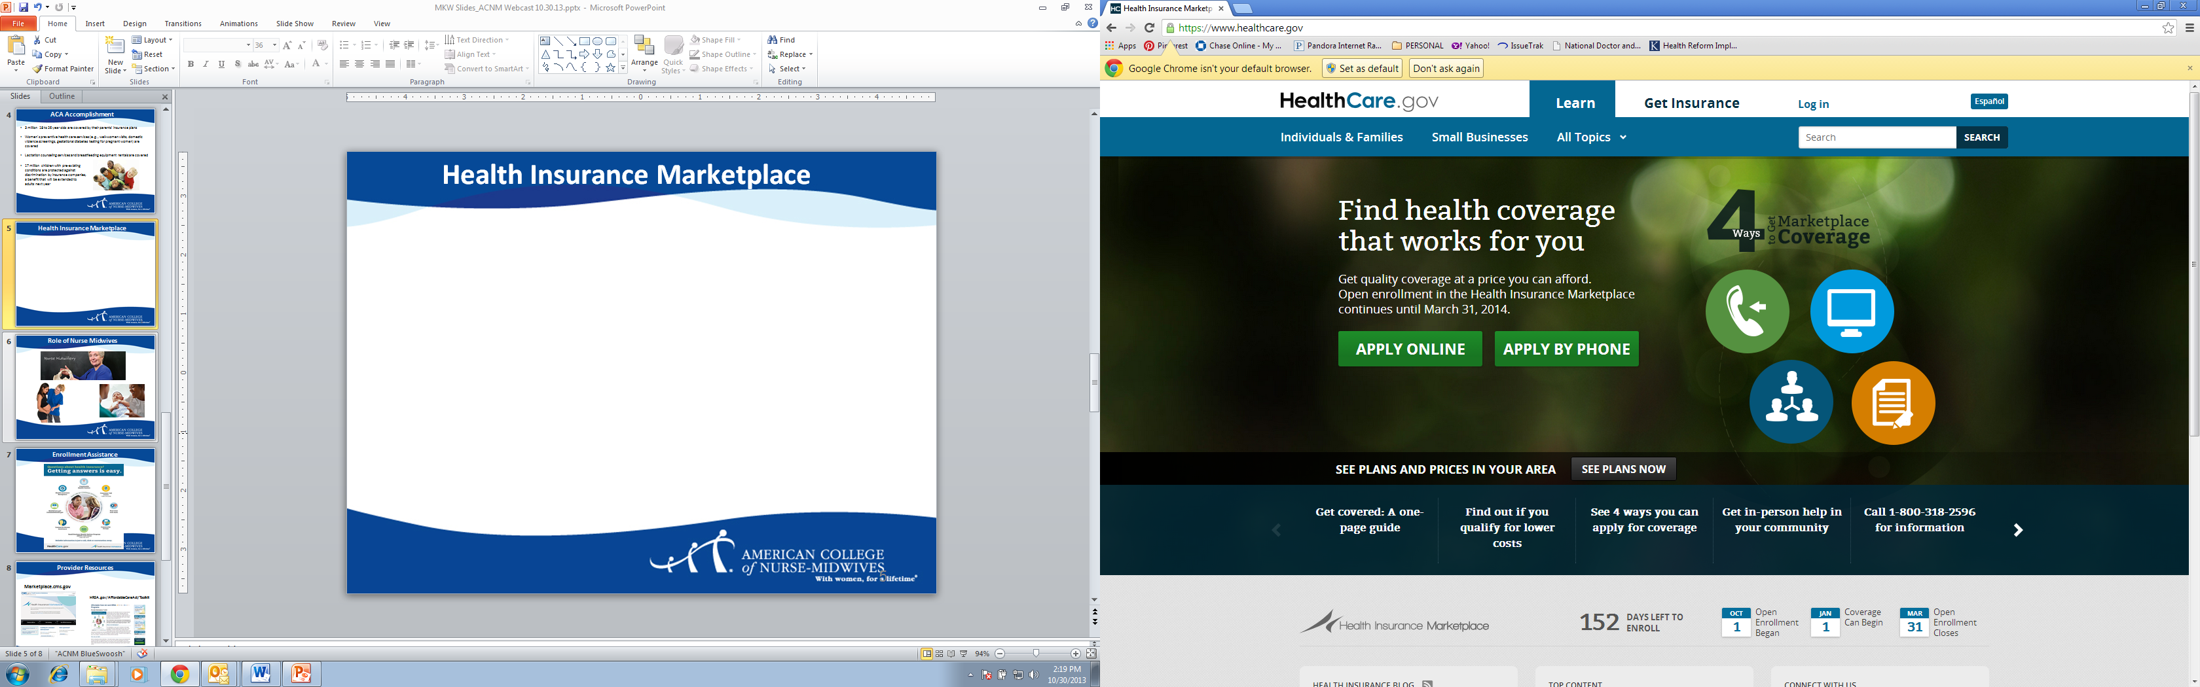
Health Insurance Marketplace

Slide 9



Nurses are a Trusted Resource
9

Slide 10
Call to Action:
Spread the Word
Help your patients, students and community members learn more about the four basic ways to apply for health coverage:
Online at HealthCare.gov
By phone at 1-800-318-2596
In-person with a trained counselor – find help in your area at LocalHelp.HealthCare.gov
By mail by downloading the paper application from HealthCare.gov
10

Slide 11
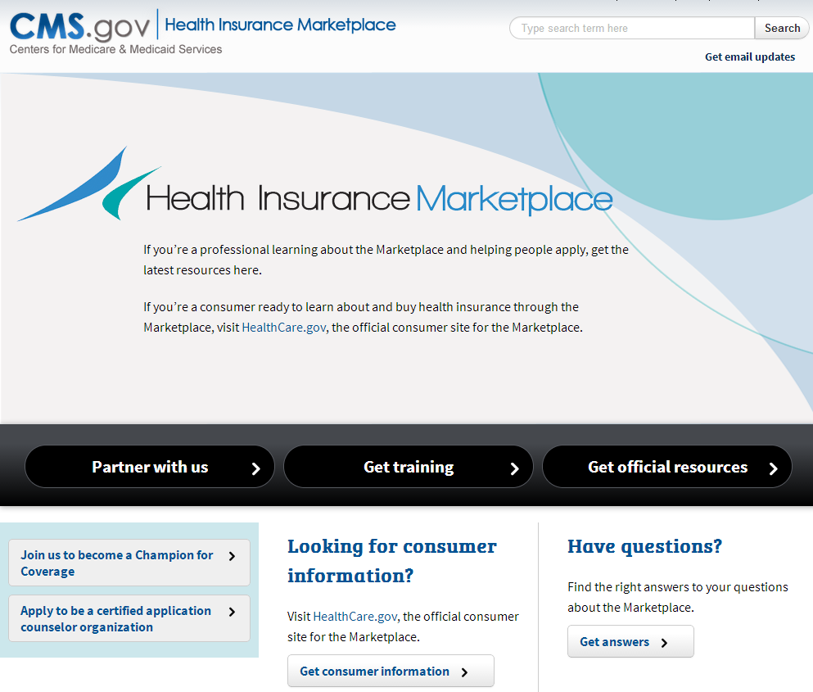
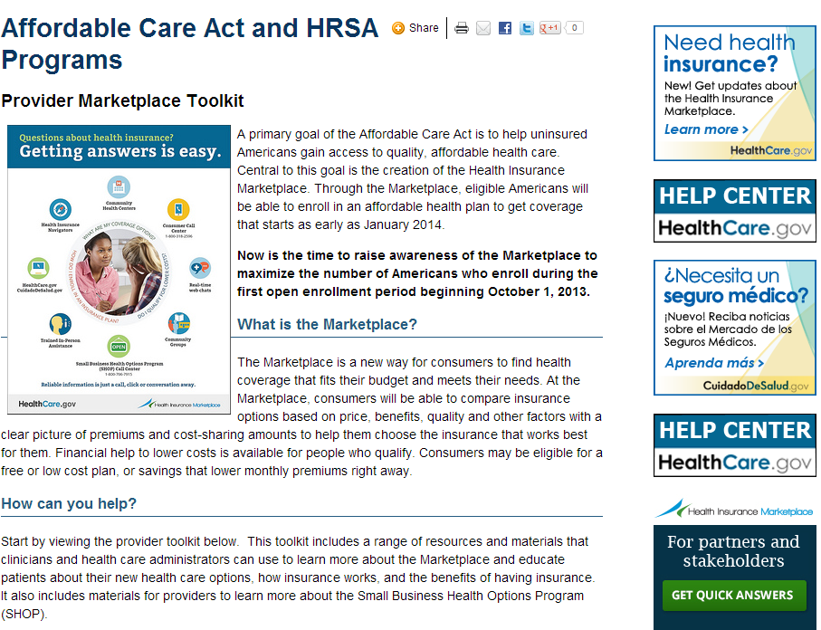
Provider Resources
Marketplace.cms.gov
HRSA.gov/AffordableCareAct/Toolkit
11

Slide 12
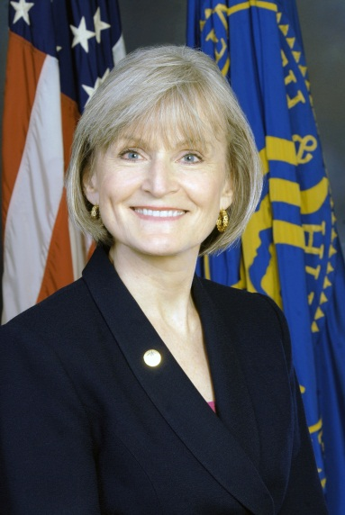
Thank You
Mary Wakefield, Ph.D., R.N.
Administrator
Health Resources and Services Administration
U.S. Department of Health and Human Services

Slide 13
Overview of Medicaid Expansion and Health Insurance Marketplaces
Jesse Bushman
ACNM Director of Advocacy and Government Affairs

Slide 14

Integration with “Our Moment of Truth”
ACNM’s multi-year, consumer campaign targeting women 18-45
Goal - improve women’s health/maternity care in US
Implementing through http://ourmomentoftruth.midwife.org/ by re-introducing midwifery care as important health care option for women to consider
Toolkit currently available to help create conversations about midwifery care: http://www.midwife.org/index.asp?bid=1412&RequestBinary=True#
Materials from HHS on the ACA could be used alongside OMOT Toolkit.

Slide 15
Medicaid Expansion

Slide 16
Coverage Change Under the ACA
Millions of Covered Lives
Source: 2010 CBO analysis. See page 23 of document available at: http://www.cbo.gov/sites/default/files/cbofiles/ftpdocs/120xx/doc12033/12-23-selectedhealthcarepublications.pdf and 2013 CBO analysis, available at: http://www.cbo.gov/sites/default/files/cbofiles/attachments/44190_EffectsAffordableCareActHealthInsuranceCoverage_2.pdf
Medicare enrollment figures are from the 2013 Medicare Trustees Report, available at: http://www.cms.gov/Research-Statistics-Data-and-Systems/Statistics-Trends-and-Reports/ReportsTrustFunds/Downloads/TR2013.pdf

Slide 17
Current Medicaid Eligibility
Pregnant
Women
Children
Parents
Elderly
Disabled
Federal law establishes income thresholds for eligibility (e.g., 133% of the Federal Poverty Level for pregnant women)
States have broad flexibility to increase income thresholds, or cover other populations. Twenty states cover pregnant women up to 185% FPL and another 17 have ceilings above those set by Federal law.
Source: “Medicaid: A Primer, 2013,” Kaiser Commission on Medicaid and the Uninsured, March 2013. Available on-line at: http://kaiserfamilyfoundation.files.wordpress.com/2010/06/7334-05.pdf

Slide 18
Medicaid Covers Nearly 50% of Births
WA
MT
ND
ME
OR
MN
VT
NH
ID
SD
WI
NY
MA
WY
MI
CT
RI
NV
NE
IA
PA
NJ
OH
DE
UT
IL
IN
CO
WV
VA
MD
CA
KS
MO
KY
DC
TN
NC
AZ
OK
< 30% of births
NM
AR
SC
MS
AL
GA
30-39% of births
TX
LA
40-49% of births
FL
50-59% of births
AK
HI
≥ 60% of births
Source: Markus, et. al., “Medicaid Covered Births, 2008 to 2010, in the Context of the Implementation of Health Reform,” Women’s Health Issues, vol. 23, issue 5, e273-e280. Available at: http://www.whijournal.com/article/PIIS1049386713000558/fulltext#tbl1 These figures represent 2010 births. Note that Delaware data for 2010 were not available, so map represents 2009 data.

Slide 19
Median Medicaid/CHIP Income Thresholds – 2013 vs. ACA Expansion
Source: “Medicaid: A Primer, 2013,” Kaiser Commission on Medicaid and the Uninsured, March 2013. Available on-line at: http://kaiserfamilyfoundation.files.wordpress.com/2010/06/7334-05.pdf

Slide 20

Medicaid Expansion and the Supreme Court
Originally the ACA required states to expand Medicaid coverage to all individuals with income up to 138% of FPL.
The Supreme Court’s decision made expansion optional.
See, “A Guide to the Supreme Court’s Affordable Care Act Decision,” Kaiser Family Foundation, July 2012, available at: http://kaiserfamilyfoundation.files.wordpress.com/2013/01/8332.pdf

Slide 21
Medicaid Expansion Among the States
WA
MT
ND
ME
OR
MN
VT
NH
ID
SD
WI
NY
MA
WY
MI
CT
RI
NV
NE
IA
PA
NJ
OH
DE
UT
IL
IN
CO
WV
VA
MD
CA
KS
MO
KY
DC
TN
NC
AZ
OK
NM
AR
SC
MS
AL
GA
Not moving forward at this time
TX
LA
Moving forward at this time
FL
AK
HI
Source: Kaiser Family Foundation Website – State Fact, available at: http://kff.org/medicaid/state-indicator/state-activity-around-expanding-medicaid-under-the-affordable-care-act/#map Current as of October 22, 2013

Slide 22
Medicaid Expansion – Key Questions
If a woman is pregnant when she applies for Medicaid, what coverage will she receive?
Will benefits under the expansion differ from pre-expansion benefits?
Yes. Pre-expansion benefits and expansion benefits are defined differently under the law. Expansion benefits must consist of at least the “Essential Health Benefits.” (more on this later).
If pregnant at the time of application, a woman would be covered under the pre-expansion package of benefits. States are required to provide coverage for women up to 133% FPL, but most have a higher income limit. States are required to cover “pregnancy-related” services, but many provide these women with the full Medicaid benefit.
Notes:
“Pregnancy-Related” Medicaid coverage does not qualify as “minimum essential coverage.” Thus, women receiving “pregnancy-related” Medicaid coverage may be subject to the individual mandate penalty. However, IRS indicated that this penalty will not apply in 2014, and that they will issue guidance on that point. 78 FR 53648.
If Medicaid had been deemed to be “minimum essential coverage” then enrollees in those programs would not have been eligible for subsidized coverage through the Marketplaces.
So, a woman who is in the “pregnancy only” Medicaid category could receive subsidized coverage through the Marketplace. It is not known how well they would coordinate.

Slide 23
Medicaid Expansion – Key Questions
Will non-pregnant women who enroll in Medicaid under the expansion and later get pregnant be able to remain in expansion coverage, or will they have to move to pre-expansion coverage?
States must inform women about the availability of coverage under the pre-expansion benefit package and must allow them to choose that option if they become pregnant. However, CMS does not expect states to shift women from expansion to pre-expansion coverage if they become pregnant.*
* See preamble discussion to the March 23, 2012 final rule at 77 FR 17149. Available at: http://www.gpo.gov/fdsys/pkg/FR-2012-03-23/html/2012-6560.htm
Notes:
The states’ incentive, with regard to women who become pregnant after enrolling in expansion coverage, is to keep them in expansion coverage because the state gets a higher FMAP for the expansion population.
Note that while pre-expansion Medicaid is required to cover birth center services, the expansion coverage is based on the EHB which may or may not cover birth centers.
Women may also be eligible for both exchange coverage and Medicaid coverage once they become pregnant. Under an exchange they would likely receive some subsidies for premiums and cost sharing, but their costs may be lower under Medicaid. It will be a complex decision.
Note that while the ACA requires coverage of birth center services under pre-expansion Medicaid, there is no such explicit coverage under the EHB (including EHB-based expansion Medicaid coverage).

Slide 24
Medicaid and Birth Center Services
The ACA Requires Medicaid programs to cover:
  Freestanding birth center services and other ambulatory services that are offered by a freestanding birth center that are otherwise covered by the Medicaid plan.
  Freestanding birth centers must be “licensed or otherwise approved by the State to provide prenatal labor and delivery or postpartum care and other ambulatory services that are included in the [Medicaid] plan.”
    If the state does not license birth centers, then this coverage requirement would not apply.
This benefit is part of the pre-expansion package.
See Section 2301 of the ACA, available at: http://housedocs.house.gov/energycommerce/ppacacon.pdf

Slide 25
Status of State Birth Center Regulation
WA
MT
ND
ME
OR
MN
VT
NH
ID
SD
WI
NY
MA
WY
MI
CT
RI
NV
NE
IA
PA
NJ
OH
DE
UT
IL
IN
CO
WV
VA
MD
CA
KS
MO
KY
DC
TN
NC
AZ
OK
NM
AR
SC
MS
AL
GA
No Regulation
TX
LA
Under Other Regulations
FL
Birth Center Specific Regulations
AK
HI
Source: American Association of Birth Centers Website, at: http://www.birthcenters.org/open-a-birth-center/birth-center-regulations Last accessed on September 9, 2013.
Notes:
New Mexico will soon have licensing for birth centers as well.
In North Carolina, where there is no state licensure, but Medicaid does recognize accreditation from the Commission for Accreditation of Birth Centers.

Slide 26
Health Insurance Marketplaces

Slide 27
The Marketplace Concept
Standardized Benefits
Standardized Levels of Coverage
One-Stop Shopping
Tools for Comparison
Help for Those who Need it
For a quick, clever video giving an overview of the Marketplaces, see: http://www.kff.org/health-reform/video/youtoons-obamacare-video/

Slide 28
Standardized Benefits
Essential Health Benefits (EHB)
What is in the law?
Ambulatory Patient Services | Prescription Drugs
Emergency Services | Rehabilitative and Habilitative Services and Devices
Hospitalization | Laboratory Services
Maternity and Newborn Care | Preventive and Wellness Services and Chronic Disease Management
Mental health and Substance use Disorder Services, including Behavioral Health Treatment | Pediatric Services, including Oral and Vision Care (pediatric oral services may be provided by stand-alone plan)
See Section 1302 of the ACA, available at: http://housedocs.house.gov/energycommerce/ppacacon.pdf

Slide 29
Defining the EHB
States define the EHB for their Marketplace by selecting one of ten options as the “benchmark” which all plans offered through their marketplace must meet. Thus, the EHB will differ among states. (See: http://www.cms.gov/CCIIO/Resources/Data-Resources/ehb.html)
Plans must provide benefits that are “substantially equal” to the EHB. States may choose to allow plans to substitute benefits within a category, so long as the substitution is “actuarially equivalent.” Thus, there may be variation among plans offered in any given marketplace.
See: 78 FR 12834, February 25, 2013, (specifically 45 CFR 156.115) available at: http://www.gpo.gov/fdsys/pkg/FR-2013-02-25/pdf/2013-04084.pdf
Notes:
The ACA does not provide much specific detail about what the EHB will consist of. It defines ten general categories, indicates that EHB must be “equal to the scope of benefits provided under a typical employer plan” and leaves the specifics up to the Secretary of HHS.
If individual states want to require plans offered in their exchange to cover items/services beyond what is in the EHB, they must bear the cost (not defined in the law exactly what it means for them to bear the cost). State mandates were a significant question.
HHS chose to allow states to select an existing plan as a benchmark that would define the EHB for plans offered through their exchange. There were ten different options for them to choose from, in four distinct groupings.
The ten benchmark options are:
(1) Small group market health plan. The largest health plan by enrollment in any of the three largest small group insurance products by enrollment, as defined in § 159.110 of this subpart, in the State’s small group market as defined in § 155.20 of this subchapter.
(2) State employee health benefit plan. Any of the largest three employee health benefit plan options by enrollment offered and generally available to State employees in the State involved.
(3) FEHBP plan. Any of the largest three national Federal Employees Health Benefits Program (FEHBP) plan options by aggregate enrollment that is offered to all health-benefits-eligible federal employees under 5 USC 8903.
(4) HMO. The coverage plan with the largest insured commercial non-Medicaid enrollment offered by a health maintenance organization operating in the State.
The default base-benchmark plan will be the largest plan by enrollment in the largest product by enrollment in the State’s small group market.
To ensure coverage of mandates, while avoiding the cost of covering them, it was most logical to choose the largest health plan by enrollment in any of the three largest small group insurance products, by enrollment, offered in the state. This is the default EHB for Federally Facilitated Marketplaces (those run by the federal government when the state chooses not to establish a Marketplace).
If a State does not make a selection, the default base-benchmark plan will be the largest plan by enrollment in the largest product by enrollment in the State’s small group market.

Slide 30
Benchmark Insurers
Notes:
Examples of local plans include Oxford health plan, Connecticare, and others.

Slide 31
Maternity Benefits in the Benchmark Plans
Prenatal and Postnatal Care
Type of Coverage | No. of Plans
Coverage for prenatal and postnatal or “maternity services” | 44
Coverage for “routine” prenatal and postpartum care | 3
Coverage for “physician” services | 2
Coverage for “professional” services | 1
Coverage for “obstetrical” services | 1
Based on ACNM analysis of benchmark documents available at: http://www.cms.gov/CCIIO/Resources/Data-Resources/ehb.html)

Slide 32
Maternity Benefits in the Benchmark Plans
Delivery and Maternity Services
Type of Coverage | No. of Plans
Coverage of “inpatient” services | 40
Coverage of “maternity” services | 8
Coverage for “obstetrical” care | 1
Coverage for “labor and delivery” | 1
Non-specific coverage | 1
Arizona’s benchmark plan provides explicit coverage for birth centers.
Connecticut’s benchmark plan explicitly excludes home birth.
Based on ACNM analysis of benchmark documents available at: http://www.cms.gov/CCIIO/Resources/Data-Resources/ehb.html)

Slide 33
“Other” Benefits in the Benchmark Plans
Coverage for “Other Practitioner Office Visit”
Type of Coverage | No. of Plans
Covered | 32
Coverage for “Nurse (or Nurse practitioner), Physician Assistant” services | 11
Coverage for “Primary Care Visit” or “PCP Services” | 3
Coverage for Nurse Midwife Services (among others) | 2
Coverage for Various Advance Practice Individuals (not including Midwives) | 3
Based on ACNM analysis of benchmark documents available at: http://www.cms.gov/CCIIO/Resources/Data-Resources/ehb.html)

Slide 34
The EHB Beyond the Marketplace
All non-grandfathered, insured plans in the individual and small group markets – on and off the Health Insurance Marketplace – are required to provide EHBs, with the start of plan years that begin on or after January 1, 2014.
  More people outside than inside the Marketplaces will be insured under EHB-based plans.
Notes:
CMS final regulation on grandfathered status estimated that as of 2013, 66% of small group plans would have given up their grandfathered status. 75 FR 34553.
According to the Kaiser Family Foundation’s most recent Employer Health Benefits Survey, in 2013, 36 percent of those who get coverage through their jobs are enrolled in a grandfathered health plan, down from 48 percent in 2012 and 56 percent in 2011.
The proportion of individual policies losing their grandfathered status, year to year, is estimated to be above the 40-67% range. It is not probable that many will be in existence as of 2014. 75 FR 34553.
In 2011, 5% of the population was insured under individual coverage and 49% under employer sponsored coverage. Source: http://kff.org/other/state-indicator/total-population/
The federal Agency for Healthcare Research and Quality estimates that in 2011, 68.5 percent of all health plan participants employed by large companies (i.e., those with more than 50 employees), and approximately 11 percent employed by small companies (less than 10 employees) were enrolled in self-insured plans. Overall, self-insured plans covered 58.5 percent of private sector health plan enrollees.
In 2008, 35% of employees worked in employers with fewer than 100 employees. Source: http://www.census.gov/econ/smallbus.html#EstabSize

Slide 35
EHB: Impact is Well Beyond the Marketplaces
EHB Acts as Benefit “Floor”
EHB Does Not Impact Benefits
* Assumes all are not grandfathered. Estimates for the percent of lives in plans that maintain grandfathered status by 2018 are <5%.
Sources: (1) U.S. Congressional Budget Office (CBO). Updated Estimates for the Insurance Coverage Provisions of the Affordable Care Act. March 2012. (2) Medicare Trustees Report, 2011. Table III.A3. (3) CBO Health Insurance Baseline, March 2011. (4) Employee Benefits Research Institute, 2012.

Slide 36
EHB Decisions May Impact up to 60% of Lives* in Some States
Highest, 58.6% of lives
WA
Lowest, 34.9% of lives
ME
MT
ND
OR
MN
VT
ID
NY
NH
SD
WI
MI
MA
RI
WY
CT
NE
IA
PA
NJ
NV
UT
IN
OH
DE
CA
CO
IL
WV
MD
KS
MO
KY
VA
NC
DC
AZ
OK
TN
50.0 to 58.6% of lives are subject to EHB
NM
AR
SC
AL
GA
46.0 to 49.9%
TX
MS
44.0 to 45.9%
AK
LA
FL
40.0 to 43.9%
HI
Fewer than 40% of lives subject to EHB
* Includes small and large group fully-insured plans, existing individual market lives, and the uninsured who may enroll in exchange-based plans or Medicaid if states chooses expansion option. Excludes pre-ACA Medicaid, Medicare, and other federal programs like VA and DoD TRICARE.
Sources: (1) Employee Benefits Research Institute, 2012., (2) State Health Assistance Data Center (SHADAC), 2012.

Slide 37

Network Adequacy
Plan networks must be available to all enrollees, include “essential community providers,” and be sufficient in number and scope to assure that all services will be accessible without unreasonable delay.
  Determining network adequacy has largely been left up to the states or accrediting bodies.
  CMS refused to define specific provider types that must be included in plan networks.
Source: 45 CFR 155.1050 and 77 FR 18409, 18419

Slide 38
Anti-Discrimination
Plans may not “employ marketing practices or benefit designs that will have the effect of discouraging the enrollment of individuals with significant health needs.”
  CMS will conduct outlier analyses, looking at specific benefit categories, including pregnancy and newborn care.
Plans “shall not discriminate with respect to participation under the plan or coverage against any health care provider who is acting within the scope of that provider’s license or certification under applicable State law.”
  A Department of Labor FAQ states “This provision does not require plans or issuers to accept all types of providers into a network.”
Source: 45 CFR 156.225, Public Health Services Act Section 2706,
and http://www.dol.gov/ebsa/pdf/faq-aca15.pdf

Slide 39
Standardized Levels of Coverage
Four standardized levels of coverage will be available.
A catastrophic plan will be available to those under 30 years old.
Bronze – 60% Coverage
Silver – 70% Coverage
For an early look at rates in 17 states and DC, see: http://kaiserfamilyfoundation.files.wordpress.com/2013/09/early-look-at-premiums-and-participation-in-marketplaces.pdf
Gold – 80% Coverage
Platinum – 90% Coverage
Notes:
Issuers must offer at least a silver and gold level plan. They may not necessarily offer bronze or platinum level plans.
Cost-sharing subsidies will only be available to individuals who qualify for subsidies and who are enrolled in a silver level plan.

Slide 40
One Stop Shopping
Marketplaces will allow consumers to:
  Compare all available plans for individuals and families
  Use a single process to determine eligibility for:
    Medicaid
    a Marketplace plan
    Premium/cost-sharing subsidies
  https://www.healthcare.gov/ - For Consumers
  http://marketplace.cms.gov/ - For Providers

Slide 41
Plans Available Across 36 States in the Marketplaces*
Number of plans across 36 states. Source: ASPE Issue Brief available at: http://www.whitehouse.gov/sites/default/files/docs/marketplace_premiums_ib_final.pdf

Slide 42
Plans Available Across 17 States in the Marketplaces
Note: this is based on a preliminary analysis of 17 states and DC that announced their data prior to October 1. It is available at: http://kaiserfamilyfoundation.files.wordpress.com/2013/09/early-look-at-premiums-and-participation-in-marketplaces.pdf

Slide 43
Weighted Average Premiums Across 48 States in the Marketplaces*
Weighted average premiums across 48 states. Source: ASPE Issue Brief available at: http://www.whitehouse.gov/sites/default/files/docs/marketplace_premiums_ib_final.pdf

Slide 44
Tools for Comparison
Benefits
Premiums & Cost-Sharing
Enrollee Satisfaction
Quality Ratings
Provider Networks
Medical Loss Ratios
For each plan available in the Marketplace, consumers will be able to make direct comparisons
A calculator for comparing plan costs will be available
Notes:
The calculator will take subsidies for premiums and cost sharing into account.

Slide 45
The Individual Mandate
In 2014, insurers will have to cover anyone, regardless of condition.
If only the sick sign up, premiums will rise.
We need EVERYONE in the pool!
Hence the “individual mandate.”
See: http://kff.org/infographic/the-requirement-to-buy-coverage-under-the-affordable-care-act/
Notes:
“Pregnancy-Related” Medicaid coverage does not qualify as “minimum essential coverage.” Thus, women receiving “pregnancy-related” Medicaid coverage may be subject to the individual mandate penalty. However, IRS indicated that this penalty will not apply in 2014, and that they will issue guidance on that point. 78 FR 53648.

Slide 46
Help for Those Who Need It
Subsidy Household Income Limits
Federal Poverty Level - 2013
 | 250% FPL | 400% FPL
Individual | $28,725 | $45,960
Family of 2 | $38,775 | $62,040
Family of 4 | $58,875 | $94,200
Percent of Federal Poverty
No subsidies for those offered affordable, adequate employer coverage.
Note – No subsidies available below 100% FPL
Premium Cost-Sharing
Subsidies Subsidies
Notes:
People offered coverage through an employer are not eligible for premium tax credits unless the employer plan does not have an actuarial value of at least 60% or unless the person’s share of the premium for employer-sponsored insurance exceeds 9.5% of income.

Slide 47
Help for Those Who Need It
Premium Subsidies
Premium subsidies will be set on a sliding scale.
Higher earners will pay a larger portion of their income as premiums.
The premium subsidy is based on the second cheapest silver plan.
Premiums as % of Income After Application of Subsidy
Subsidy Calculator:
http://kff.org/interactive/subsidy-calculator/
% Federal Poverty Level

Slide 48
Help for Those Who Need It
Cost-Sharing Subsidies
Cost sharing will be reduced, based on income, for those enrolled in a Silver level plan.
Maximum out of pocket levels will also be reduced.
Income Level | 2014 Max Out of Pocket
100-150% FPL | $2,250/$4,500 (Individual/Family)
150-200% FPL | $2,250/$4,500
200-250% FPL | $5,200/$10,400
Income Level | Plan Actuarial Value
100-150% FPL | 94%
150-200% FPL | 87%
200-250% FPL | 73%
Unsubsidized amounts are $6,350 for an individual and $12,700 for a family.
Source: 78 FR 15483, available at: http://www.gpo.gov/fdsys/pkg/FR-2013-03-11/html/2013-04902.htm
Notes:
They May 2013 CBO Baseline indicates that in 2014 the average subsidy, per subsidized enrollee, will be $5,290.

Slide 49
Small Business Health Options Program (SHOP)
Small businesses may send their employees to the Marketplaces to obtain insurance.
Employers choose a plan(s) and the level of support to provide. Employees pick from among available options.
  Employers may qualify for a small business health care tax credit worth up to 50% of their premium costs for plans purchased through the SHOP and can still deduct the rest of their premium costs not covered by the tax credit from their taxes.
Notes:
In 2014, employers can get the Small Business Healthcare Tax Credit only when they buy coverage through the SHOP. It applies to businesses with fewer than 25 FTEs with average salaries of about $50,000 or less.
Small businesses are those with up to 50 employees in 2014-15 and up to 100 in 2016. In 2017, the Marketplaces may allow employers with 100+ employees to obtain insurance through them.

Slide 50
Consumer Assistance
Each exchange must establish specified consumer assistance tools.
Call Center
Website
Navigator

Slide 51
Enrollment
Open season for the 2014 plan year runs October 1, 2013 – March 31, 2014.
  Enrollments up to 12/15 will be effective 1/1/14.
  Enrollment up to the 15th of a month are effective the 1st of the following month.
  Open season for subsequent years will run 10/15 – 12/7.
Examples of Special Enrollment Periods
  Losing minimum essential coverage (such as employer coverage)
  Gaining or becoming a dependent
  Change in citizenship/legal status
  Changes in subsidy eligibility
  A permanent move

Slide 52
Status of Health Insurance Marketplaces
WA
MT
ND
ME
OR
MN
VT
NH
ID
SD
WI
NY
MA
WY
MI
CT
RI
NV
NE
IA
PA
NJ
OH
DE
UT
IL
IN
CO
WV
VA
MD
CA
KS
MO
KY
DC
TN
NC
AZ
OK
NM
AR
SC
Default to Federal Marketplace
MS
AL
GA
TX
Planning Partnership Marketplace
LA
FL
Declared State-Based Marketplace
AK
HI
Source: Kaiser Family Foundation Website – State Fact, available at: http://kff.org/health-reform/state-indicator/state-decisions-for-creating-health-insurance-exchanges-and-expanding-medicaid/#map Current as of September 3, 2013

Slide 53
Dollars and Cents (Lots of ‘em!)
2013-2022 Revenues
2014-2023 Costs
ACA Total - $1.8 Trillion
Premium and Cost Sharing Subsidies - $950 Billion
Source: CBO May 2013 Baseline - http://www.cbo.gov/sites/default/files/cbofiles/attachments/44190_EffectsAffordableCareActHealthInsuranceCoverage_2.pdf and July 24, 2012 CBO letter to Rep. John Boehner, available at: http://www.cbo.gov/sites/default/files/cbofiles/attachments/43471-hr6079.pdf

Slide 54
Questions

